Slide 1
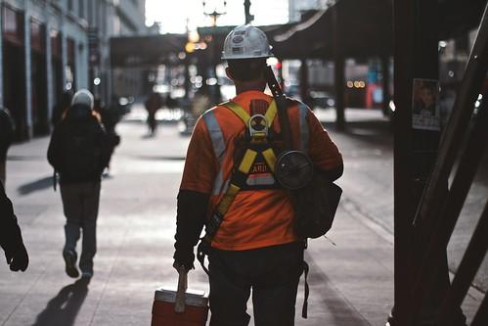
Massachusetts Climate Careers: Powering the Future
Climate Hero Spotlight: Construction, Installation, and Maintenance Workers
Notes:
Today, we’ll dive into the essential roles that construction, installation, and maintenance workers play in advancing climate solutions.
These jobs help to build the clean energy projects that power Massachusetts, and they offer many career opportunities with all types of skill sets!

Slide 2
Opening Activity
Think back on an activity you completed for any previous lesson in this class.
How do construction, installation, or maintenance workers make that project possible?
Lesson 15: Construction, Installation, and Maintenance Workers
Notes:
Opening activity: Get students thinking and talking right away.
Instructions:
Divide the students into small groups of two or three.
Ask the students to think about an activity they did for any previous lesson in this class.
Ask them to discuss in their groups: How do construction, installation, or maintenance workers make that project possible? Examples:
Energy efficiency improvements to the building envelope
High-performance buildings with efficient HVAC systems
Community solar projects
Networked geothermal projects
Offshore wind projects
EV charging networks
Ask them to share with their group how construction or installation workers made that project possible and what key role the workers contributed.
Ask one or two groups to share aloud with the rest of the class.

Slide 3
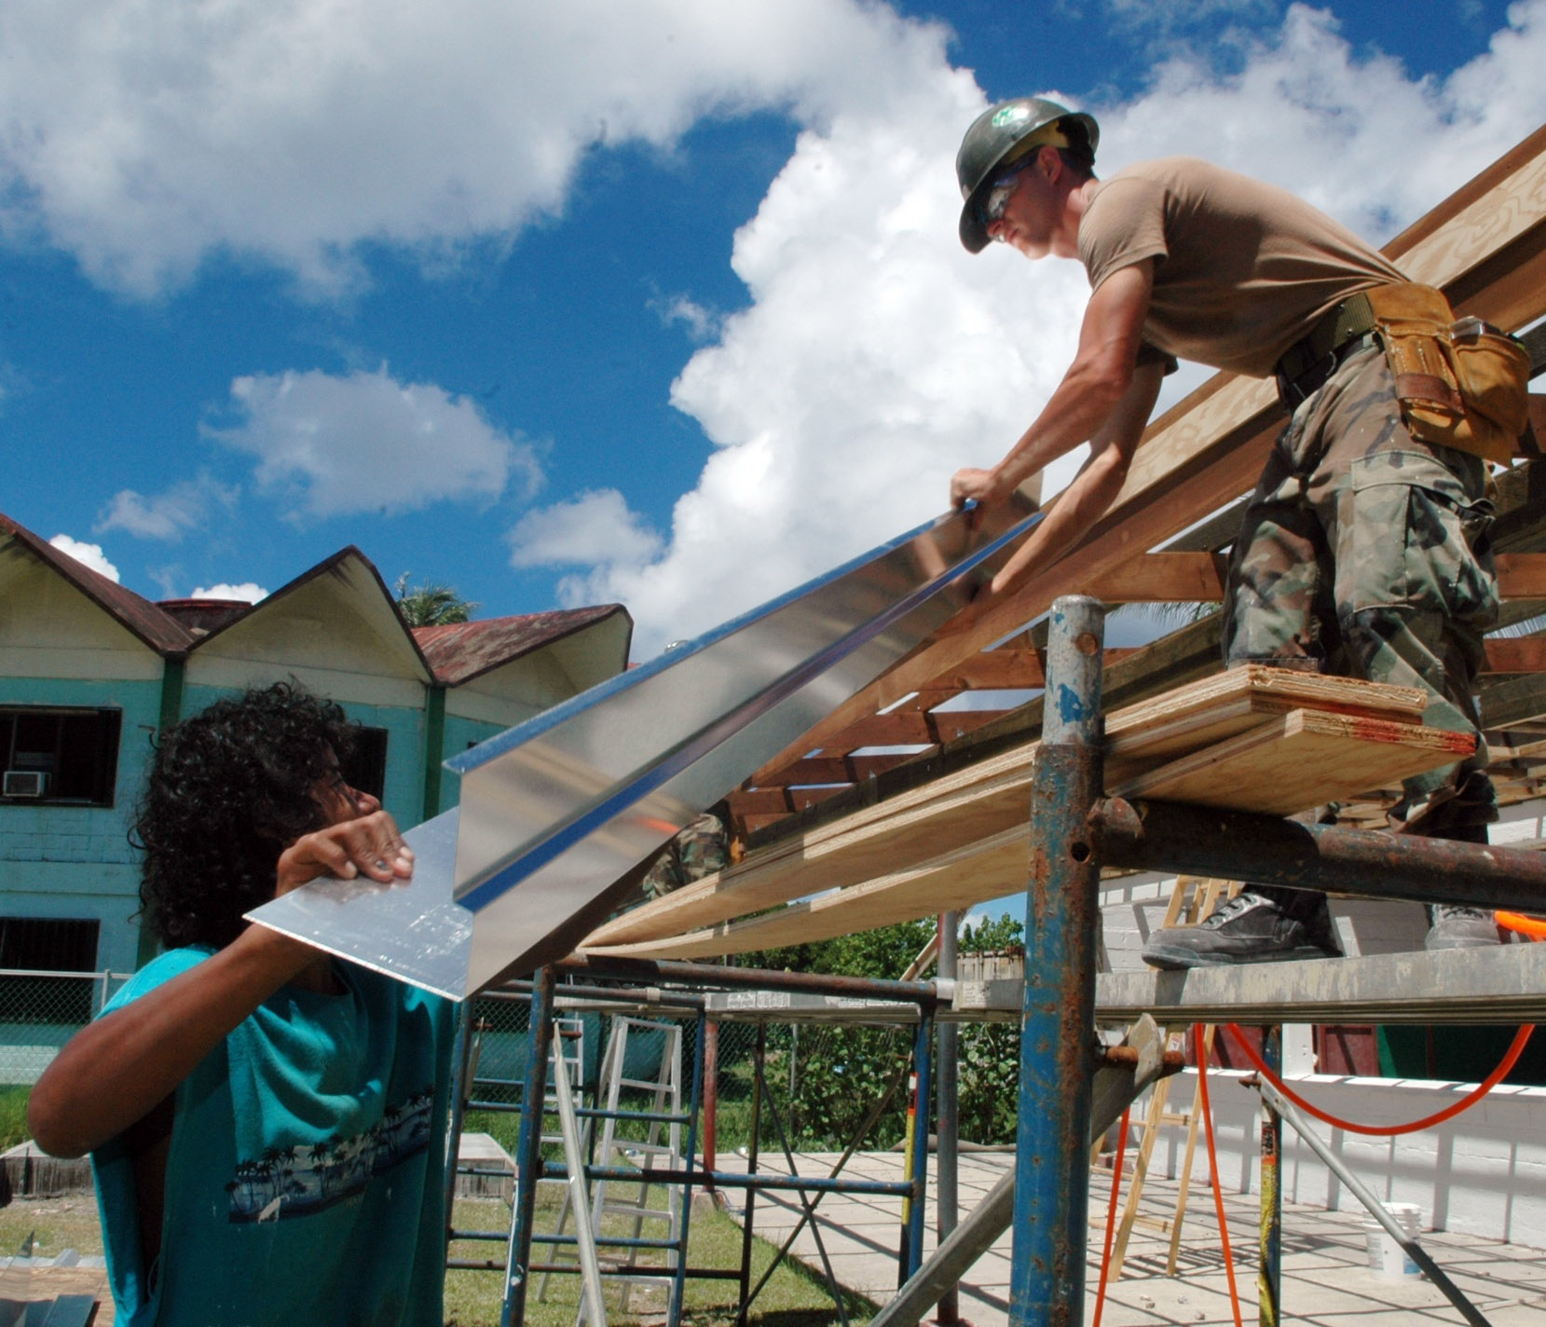
Today’s Agenda
The Big Question and My Climate Goals
Introduction to Construction, Installation, and Maintenance Careers
Career Paths, Skills, and Training
Recruit Your Project Dream Team
Takeaways and Closing
Lesson 15: Construction, Installation, and Maintenance Workers

Slide 4
How do construction, installation, and maintenance workers contribute to climate solutions?
Lesson 15: Construction, Installation, and Maintenance Workers
Notes:
Today, we’re interested in exploring the Big Question: How do construction, installation, and maintenance workers contribute to climate solutions?

Slide 5
My Climate Goals
When you complete this lesson, you’ll be able to
Identify various construction and maintenance careers in climate solutions
Understand the growing demand for these roles due to state climate goals
Explore the skills and training needed for these careers
Discuss how these careers align with your personal interests and skills.
Lesson 15: Construction, Installation, and Maintenance Workers

Slide 6
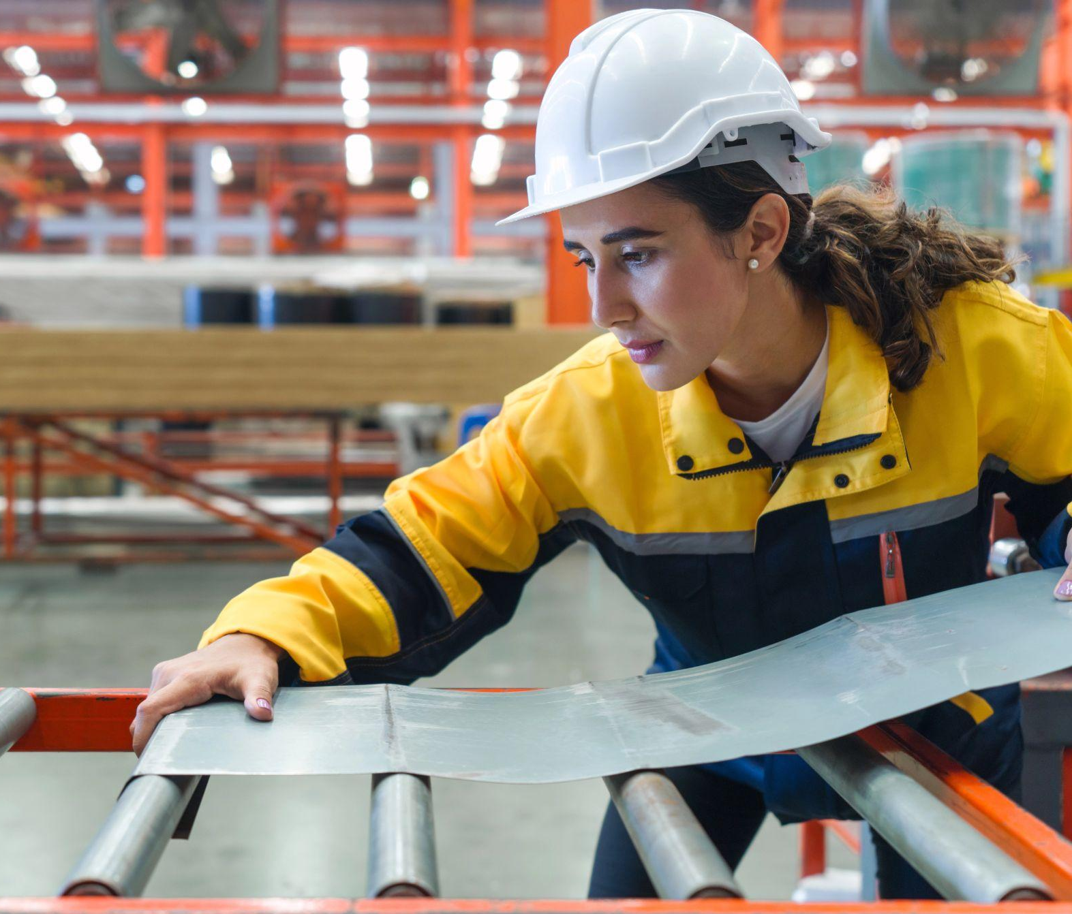
Job Types
Construction workers
HVAC technicians
Weatherization technicians
Plumbers and pipefitters
Sheet metal workers
Wages range from $22/hour to $35/hour. Prevailing wage rates can be higher.
Lesson 15: Construction, Installation, and Maintenance Workers
Notes:
Review each type of worker by first asking students to briefly explain what they believe each job type is and then fill in what they miss.
Construction workers: Build the infrastructure for clean energy projects. They work on everything from setting up solar array foundations to installing insulation.
HVAC technicians: Install energy-efficient systems.
Weatherization technicians: Make buildings more energy-efficient by adding insulation.
Plumbers and pipefitters: Install efficient heating systems and reduce water waste.
Sheet metal workers: Manufacture and install energy-efficient duct systems.
These roles all directly impact building a cleaner, healthier Massachusetts.
Meeting our climate goals means there will be increased demand for these roles.
Construction workers will be needed for all types of clean energy projects, including energy-efficient building projects and retrofits, installing electric vehicle (EV) infrastructure, and the infrastructure that supports utility-scale solar projects.
Weatherizing homes to improve their efficiency and envelope requires adding insulation, sealing air leaks, updating windows and doors, and making other upgrades. Weatherization techs help with all of these projects.
Technicians who install efficient heat pumps, water heaters, and other HVAC systems will continue to help residents transition away from fossil-fuel-dependent systems.
Those same HVAC systems and other duct systems require sheet metal workers, who are also involved in building new energy-efficient buildings and retrofitting older buildings.
No matter the project, these people are essential to getting it done.
Many of these roles are eligible for unions, and many of these roles and the projects they work on can be subject to prevailing wage laws, which can mean higher wages.

Slide 7
MA Climate Goals
We need skilled workers to install energy-efficient systems, weatherize homes, and support green infrastructure projects to reach Massachusetts's ambitious climate goals.
Goal: Weatherize 185,000+ homes and small businesses between 2025 and 2027
Lesson 15: Construction, Installation, and Maintenance Workers
Notes:
As Massachusetts works toward climate goals, demand for HVAC technicians, insulation experts, weatherization technicians, and other skilled workers is rising.
According to the Massachusetts Energy Efficiency and Decarbonization Plan, between 2025 and 2027, Massachusetts plans to weatherize over 185,000 homes and small businesses.

Slide 8
Skills and Training Needed
Necessary Skills:
Strength and stamina
Math and measuring skills
Reading blueprints
Operating tools and machinery
Available Training:
OSHA 10 Certification
New England Laborers’ Training Academy
Specialized training centers
Lesson 15: Construction, Installation, and Maintenance Workers
Notes:
Careers in these fields are accessible partly because training opportunities are widely available, even if you are looking for highly specialized training in a specific skill set.
These are some of the primary skills that you need to be successful in these careers:
Strength and stamina: All of these careers are physical and labor-intensive, at least some of the time. Even if you are interested in a specialization focusing on something requiring less strength, you would need to be trained more generally first.
Most of these roles require a decent math level, especially regarding measurement. Geometry and measurement are critical in any building project.
Most of these roles require reading blueprints or other schematic diagrams. If you enjoy reading visual maps, consider this.
Finally, all of these roles rely on the use of specific tools and machinery. It is critical to recognize tools, use them, learn new tools, and know what to use when.
Training depends on the specific field you want to enter. Some general training offerings are probably required or recommended regardless of your specialty.
OSHA 10 certification is a safety certification that is required for anyone who will be working on a job site. In most cases, you wouldn’t be allowed on a job site without this certification. Sometimes, jobs may require a higher certification, like an OSHA 30, but OSHA 10 is the minimum.
The New England Laborers’ Training Academy in Hopkinton, MA, is a union training center where workers can receive training even if they have little to no formal training.
Workers can also seek out specific licenses and certifications. For example, you could get a Construction Supervisor License, which would allow you to receive a higher pay rate and would allow you to be a supervisor or manager on a job site.

Slide 9
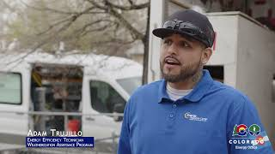
Climate Watch: Video
Courtesy CO Energy Office
Lesson 12: Climate Hero Spotlight: Engineers
Notes:
MassCEC Video is coming by Spring 2025.
This video is a placeholder. The Weatherization Assistance Program employs technicians, crew leaders, energy auditors, and quality control inspectors. The se professionals help improve the lives of income-eligible residents nationwide by enhancing buildings' safety, comfort, and durability.
Career Opportunities in the Weatherization Assistance Program, CO Energy Office
https://youtu.be/xIKIvsSe0eo?si=XcUvUa3Rhna1ze7B
The MassCEC-produced video should feature students from Greenfield Community College.

Slide 10
What is one thing you learned?
What is most surprising about the weatherization process shown in the video?
What skills or expertise seem more important for the weatherization process?
Climate Watch Discussion
Lesson 12: Climate Hero Spotlight: Engineers

Slide 11
Group Activity
Recruit Your Project Dream Team
Determine which construction or installation workers are needed to complete your clean energy project:
What workers are needed?
What skills are required?
What challenges might the project face?
Lesson 15: Construction, Installation, and Maintenance Workers
Notes:
Activity O bjective: Students will develop critical thinking, teamwork, and problem-solving skills while learning about the unique and specialized contributions of different construction, maintenance, and installation workers to clean energy projects.
Recruit Your Project Dream Team:
Determine which construction or installation workers are needed to complete your clean energy project:
What workers are needed?
What skills are required?
What challenges might the project face?
Instructions:
Divide the students into groups and assign each group one of the four clean energy projects from their worksheets:
Group 1: Solar panel installation on a school building
Group 2: Weatherization of an apartment building to improve energy efficiency
Group 3: Installation of EV charging stations in a downtown community parking lot
Group 4: Installation of heat pumps in a community of residential homes to replace oil or gas heating
Instruct students to work in their groups to assemble their “dream team” of construction, installation, and maintenance workers to complete the project. Advise them to
Consider the skills, tools, and expertise needed to complete the project
Consider the challenges the project is likely to face and the roles that will be best suited to help overcome them
Decide which roles they want to “hire” on their project crew.
Ask the students to present their project and their assembled crew to the class (approximately one minute per presentation).

Slide 12
How do these teams contribute to clean energy and climate goals?
Which skills were needed most often across these projects?
Which skills can help meet the common challenges these projects would face?
Activity Debrief
Notes:
Presentations and debrief
Discuss the different approaches groups took to build their teams.
How do these teams contribute to clean energy and climate goals?
Draw attention to recurring skills (technical skills such as electrical work or general skills problem-solving). Discuss
Which skills were needed most often across these projects?
Which skills can help meet the everyday challenges these projects would face?
Connect each group’s project and presentation to the Big Question: how do these workers contribute to climate solutions?
Connect each group’s presentation back to the learning objectives.
Discuss common challenges such as weather, space limitations, or safety concerns. Explain that the success of these projects requires workers who can adapt to these circumstances.
Highlight that students’ “dream teams” reflect the real-world teams that Massachusetts needs to reach its climate goals.

Slide 13
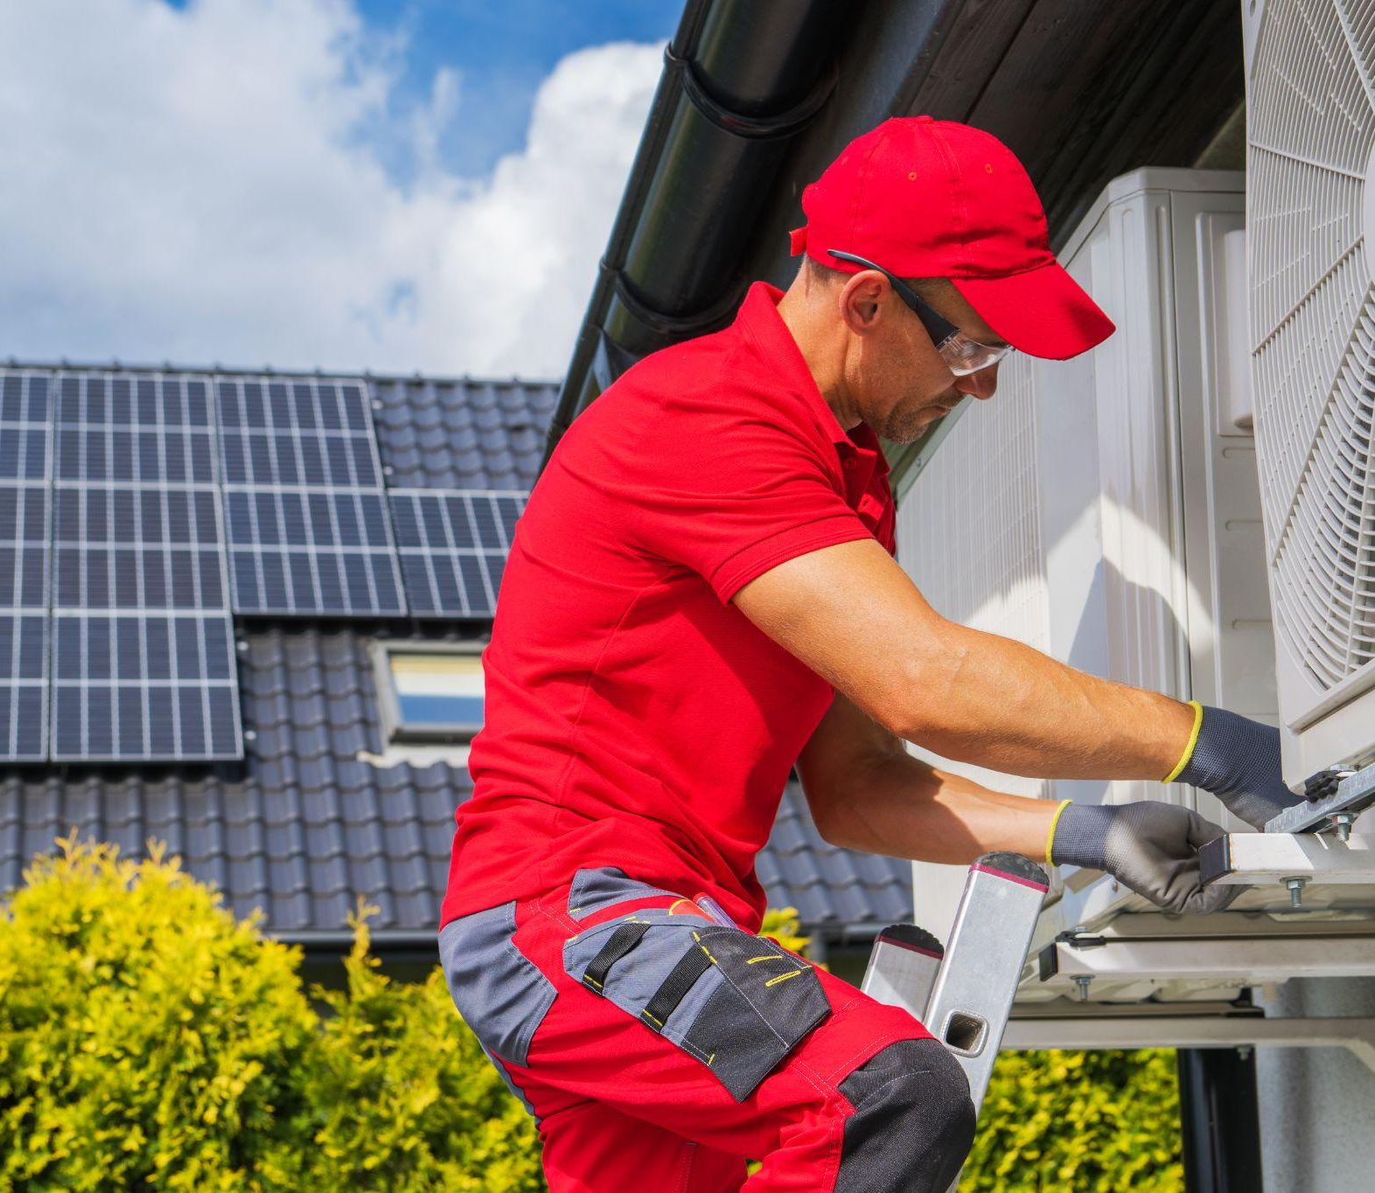
Key Points
Construction and maintenance careers are critical to climate goals.
These jobs require hands-on skills, and there are many ways to gain training.
Exploring these careers can lead to meaningful work in clean energy sectors.
Lesson 15: Construction, Installation, and Maintenance Workers
Notes:
Reiterate the key points from today’s lesson.
Remind students of the different construction, installation, and maintenance pathways.

Slide 14
What specialized skills distinguish construction, installation, and maintenance workers?
What questions do you still have about skills and training for these careers?
In what ways are construction, maintenance, and installation workers critical to the clean energy transition?
Closing Activity
Lesson 15: Construction, Installation, and Maintenance Workers
Notes:
Activity objective: Encourage students to reflect on key takeaways and identify areas of curiosity for further exploration.
Ask students to take one minute to think about the lesson and respond to these questions:
What specialized skills distinguish construction, installation, and maintenance workers?
What questions do you still have about skills and training for these careers?
In what ways are construction, maintenance, and installation workers critical to the clean energy transition?
Go around the room, asking students to share their answers.
Encourage brief discussions or clarifications if students’ questions are particularly thought-provoking.

Slide 15
|
15

